Slide 1
Content migration: from the old to the new Sounds.bl.uk website

Slide 2
The aim of the migration project is to make sure that content available on the current Sounds website becomes available on the new Sounds website. For this to happen, several steps are necessary:
Items should be fully catalogued in SAMI (both sides for double-sided carriers).
SIPs (Submission Information Package) must be built to preserve both files and non bibliographic metadata associated to preserved items. The whole content on physical items must be preserved (no selective preservation).
Non bibliographic metadata are: Structural metadata (layout of recorded content on physical carriers), Technical metadata (equipment used to digitise analogue items), Logical structure metadata (how audiofiles should be played back), Administrative metadata (copyright status and digitisation funder).
SIPs must be submitted and successfully ingest in the DLS.
Once SIPs are ingested, Logical arks are generated (one per PROD and one per REC entry).
SAMI must be updated with Logical arks (both in PROD and REC entries).
The interaction between the website and SAMI (through L-arks) allows the website to display the bibliographic metadata and to arrange items in their own website category and/or collection page.
The interaction between the website and information stored via the SIP tool instead, allows the website to mainly (but not only) apply copyright restrictions and to play audiofiles in the correct sequence.

Slide 3
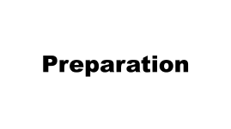


Migration workflow

Slide 4
Preparation

Slide 5
Information needed
METADATA from SOUNDS.bl.uk
FILES (audio and images)
TECHNICAL METADATA
RAQ ID (copyright)
DIGITISATION FUNDER
Bibliographic metadata on Sounds.bl.uk are stored in xml files. The spreadsheet with extracted metadata from Sounds can be obtained by running the Python script provided.
The files can be retrieved in several ways:
They can be already available in the Sound Archive shared folder
If previously ingested, they can be downloaded from the DLS
Curators might have them in department’s hard drives
Original items can be re-transferred by Technical Services
It is advisable to always create a second copy of the files.
Technical metadata can be available from different sources:
They may be available in the {565} and {566} catalogue notes in PROD or REC entries
They can be extracted through MediaInfo
They can be retrieved by extracting data from the meta xml files (if available in Sound Archive shared folder
Spreadsheets with tech metadata from previous transfers can be available at shared folder XXXX
Senior employees might remember or might know where they are
All the above failing, all the transfer equipment info at stage 5 of the SIP tool will be unknown.
Curators to determine the correct RAQ ID for each collection and individual items. The most commonly used are:
17.3: streaming only
17.4: reading room only
17.7: viewable everywhere, except in the US
17.8: streaming+embeddable
1.1: open domain,viewable everywhere, high resolution downloads permitted
17.5 : staff only access
As agreed, images will be displayed on the website even if associated to restricted audioifiles. You don’t need RAQ IDs for images.
As for transcripts, if you want to make them downloadable & embeddable, please use 17.1.
Curators to determine the funder of the digitisation
(analogue items).
The options available in the SIP tool for migrated content include:
National Life Stories
The British Library
JISC

Slide 6
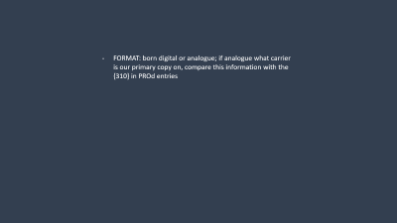
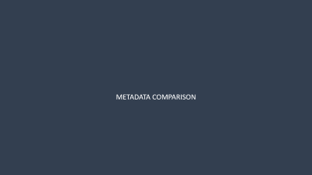
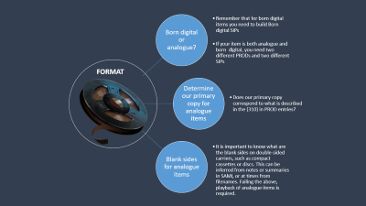
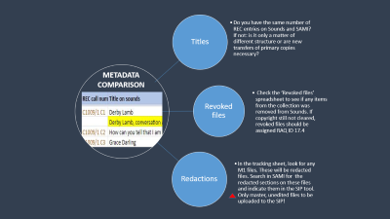
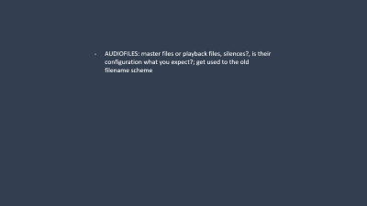
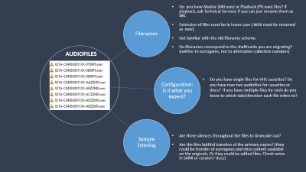
Checks

Slide 7
Born digital or analogue?
Remember that for born digital items you need to build Born digital SIPs
If your item is both analogue and born digital, you need two different PRODs and two different SIPs
Determine our primary copy for analogue items
Does our primary copy correspond to what is described in the {310} in PROD entries?
Blank sides for analogue items
It is important to know what are the blank sides on double-sided carriers, such as compact cassettes or discs. This can be inferred from notes or summaries in SAMI, or at times from filenames. Failing the above, playback of analogue items is required.
FORMAT

Slide 8
Filenames
Configuration: Is it what you expect?
Sample listening
Do you have Master (M0.wav) or Playback (P0.wav) files? If playback, ask Technical Services if you can just rename them as M0.
Extension of files must be in lower case (.WAV must be renamed as .wav).
Get familiar with the old filename scheme.
Do filenames correspond to the shelfmarks you are migrating? (neither to surrogates, nor to alternative collection numbers)
AUDIOFILES
Do you have single files for VHS cassettes? Do you have max two audiofiles for cassettes or discs? If you have multiple files for reels do you know to which side/direction each file refers to?
Are there silences throughout the files to timecode out?
Are the files faithful transfers of the primary copies? (they could be transfer of surrogates and miss content available on the originals. Or they could be edited files. Check notes in SAMI or curators’ docs)

Slide 9
Titles
Do you have the same number of REC entries on Sounds and SAMI? If not: is it only a matter of different structure or are new transfers of primary copies necessary?
Revoked files
Check the ‘Revoked files’ spreadsheet to see if any items from the collection was removed from Sounds. If copyright still not cleared, revoked files should be assigned RAQ ID 17.4
Redactions
In the tracking sheet, look for any M1 files. These will be redacted files. Search in SAMI for the redacted sections on these files and indicate them in the SIP tool. Only master, unedited files to be uploaded to the SIP!
METADATA COMPARISON

Slide 10
Cataloguing

Slide 11
Bibliographic metadata
Run a PROD/REC SAMI report before you start any work on the collection.
Check that both PROD and REC entries are in SAMI (search by keyword, rather than browsing).
If you create PROD or REC entries, please wait 24hr before building a SIP. Do not duplicate entries already ingested via the SIP tool (i.e. displaying {975}s in SAMI).
{087} and {091} in PROD entries to fix, otherwise the SIP tool will list multiple fields to pick up from. Ideally {091}s to delete from REC entries too.
{310} in PROD entries must refer to our primary copy. Add a second {310} for PDF files or images, if available.
{634}s, {633}s, {301}, {246}, {260}, {702}s are compulsory fields.
Revoked items: no {634} web category in REC entries for these items.
Check that call numbers in REC entries mirror the audiofiles (If audiofiles are split in Side1 and Side2, you should have S1 and S2 in the call numbers in SAMI, and viceversa. If no sides on filenames, then just a sequence of cuts for call numbers).
Call numbers: no odd suffixes (ex. [BL REF]).
If interested, check the spreadsheet with users’ comments from the current Sounds website available at the Sound Archive shared folder.

Slide 12
Structural metadata
Logical
Before you can build the SIPs, any structural change required to the entries should be addressed, ideally in the tracking sheet: PROD groupings, REC merging, PARENT entries.
Also, the logical sequence of files or cuts should be determined and mirrored in REC call numbers (Ex. C791/13/ S1 C1, C3, C5)
Physical
Establish the blank sides for cassettes and discs and make sure that the REC call numbers reflect the correct layout (Ex: no 1CL0024222-1CL0024226 D1-D3 if last disc is one sided, please opt for a range or anything that hints to the correct layout 1CL0024222-1CL0024226 S1)

Slide 13
SIP building

Slide 14

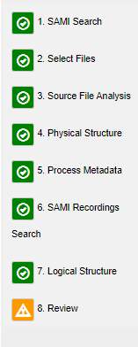


- Make sure you build ‘New SIP’ for analogue items and ‘New SIP (Born Digital)’ for born digital items. If content was recorded partly on analogue carriers and partly on digital files, you need two PROD entries and two REC entries. The SIP tool can not handle hybrid SIPs.
- SIPs for born digital collections where there is a 1:1 correspondence between REC entries and audiofles can be created via a batch upload (New Batch Upload (Born Digital). LC to train interested curators.
SIPs for analogue collections can be created from an Excel spreadsheet (New Excel Batch upload). Tom Ruane to train interested curators.
Files should be uploaded according to their logical sequence.
Possible outcomes:
1) All files are successfully transformed and analysed (proceed to stage 4)
2) Born digital audiofiles fail analysis (log the issue in shared document)
3) Digitised audiofiles fail analysis (please, contact Technical Services via mail to have it fixed)
4) Audiofiles fail transformation (make sure you have renamed the files as .wav in lower case; failing this, please contact Technical Services to have these fixed)
5) TIF files fail transformation: please contact Adam Tovell
6) JPG files fail transformation or analysis (contact Technical Services)

Slide 15





Make sure you are familiar with the old filename scheme and assign the right audiofiles to the right item/side.
Disc labels must be added to the main nodes (where audiofiles are added).
Transcripts and images which don’t refer to specific sides are usually added as supplementary files to the extra node at the bottom of the page, with their own label to be specified.
Technical metadata retrieved during the preparation phase are added at stage 5. Information needed: engineer, transfer date, equipment used. If new partial transfers are requested, custom metadata should be added to.
Stage 6 involves the selection of REC entries. These should be selected in their logical playback sequence.
RAQ IDs and digitisation funders (for analogue items) are added at stage 7.
Timecodes also should be added, if required. The Hadoop tool can be used to identify timecodes, provided that both master and original playback files (single tracks uploaded to Sounds) are available. This version of the Hadoop can be run on one side/item at a time. Besides, it only works if it is known which playback files were derived from the master side being queried.
Submission stage.
If there are problems with submission or ingest, these will be dealt with by the Workflow Support Officer.

Slide 16
Thank you
Questions?

